Slide 1
Increasing Officer Mental Health for the Long Haul: Introducing an Innovative and Customizable Online Mental Health and PTSD Prevention Training Tool.
Law Enforcement & public Health Conference 2018
October 24, 2018
Yasmeen Krameddine, PhD

Slide 2
Overview
The Opportunity
Evidence Informed
Resilience
The Research Plan
The Game Plan
Resilience Training

Slide 3
The Opportunity
Occupational Health and Safety Grant – Government of Alberta Department of Labour
Funding to create an interactive online training program for increasing resilience in police organizations
Collaboration with police service
  Short modules (8 – 15 minute modules)
  Voluntary
  Prevention not treatment
  Entire Organization
Notes:
We aim to increase resilience in 500 Canadian police officers through an online scenario-based training tool using current evidence-based practices in cognitive theory and e-Learning.

Slide 4
Evidence Informed Online Training
Online & adult informed learning principles
  Engaging and Interactive: Gamification with scenarios
  Sense of control
  Learning about the self
  Motivated to learn
  Reinforce skills developed

Slide 5
What is Resilience?
Multidimensional
  Outcome oriented: ﻿
        Lack of distress or stress load
        Successful coping
        Protective ﻿attitudinal and behavioral characteristics

Slide 6

The Research Plan
Finalize training with Police Feedback
Posters Promoting Training
Training Delivered (first come first serve)
Post-Training Questionnaire
Report on Results
Create Training
Pre-Training Questionnaire
July 2019 & July 2020
June
2019
February
2019
January
2019
January
2019
November
2018
Notes:
Questionnaires:
Short scales
(PTSD, Resilience, Depression, Anxiety, Self-esteem, & Quality of Life)

Slide 7



The Game Plan – Custom Training
Online (30 minutes)
Main organizational and operational stressors
Resources for resilience
Protective factors overview
Online (2 hours)
Implementation into your life
Specific strategies for organizational and operational stressors
Leadership Training
In-person (4 hours)
Bringing teams together
Sense of purpose
Sustainability
Notes:
Evidence informed research
Evidence informed online training principles
Evidence informed adult principles
=
Bronze – Quick online – mentioning services and giving a basis about what resilience is
Silver – Full online focusing on specific resilience strategies
Gold – Full day, in person training for squads and leaders. Bringing everyone together to focus on teamwork and an ultimate sense of purpose.

Slide 8

Training
Welcome
Notes:
Thank you for choosing to be here with me today
It is my goal in the next 10 minutes to give you a presentation that will change the way you think for the rest of your life. It is your choice if you want to participate because this will not be the average LEPH presentation session. I want you to walk away from this presentation thinking to yourself “I learned something”. What do you say?

Slide 9
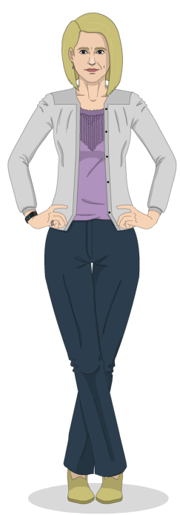
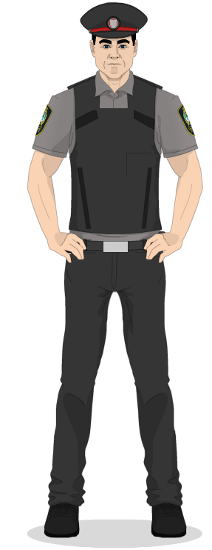
What do you say?
LETS DO IT!!!

Slide 10
QUIZ
Who is responsible for your mental health?
        I am
        My organization
        Both myself and my organization
Resilience, intelligence, and skills, grow with hard work?
        Yes
        No
        I am not sure

Slide 11
Module 1 - Emotional Intelligence
The capacity to be aware of, control, and express one's emotions, and to handle interpersonal relationships judiciously and empathetically.
Self-awareness.
Self-regulation.
Motivation.
Empathy.
Social skills.
(Goleman, 1998)
Notes:
Emotional intelligence relates to decision making

Slide 12
Step 1 -Mindfulness
1. Mindful/self awareness
Yes, I am Stressed
Notes:
Heart rate?
Breathing?
Pay attention to your body sitting in your seats.

Slide 13
Step 2 - Understanding Stressors
1. Mindful/self awareness
Yes, I am Stressed
2. What is stressing you out?
In the middle of the page, write down your top 3 stressors
Stressor 1
Stressor 2
Stressor 3

Slide 14

Step 2 – Understanding Stressors
1. Mindful/self awareness
Yes, I am Stressed
2. What is stressing you out?
- Is there too much on your plate?
- What can you remove? Delegate?
- Procrastination from lack of confidence?
Notes:
News paper?
Negative friend?
What skills do you need to build to feel confident? Where can you learn them? Who can you ask?

Slide 15
Step 3 - Coping
1. Mindful/self awareness
2. What is stressing you out?
3. Solution or self focused coping?
Control Do not control
-
-
-
Self-focused coping
Coping that doesn’t change the problem situation, focusing instead on changing oneself to better manage stress
Solution Focused Coping
Coping that is aimed at finding solutions to the problem, breaking down the problem into manageable parts, prioritizing, taking action, before it becomes a threat
Notes:
Coping effectively: Explore what you do and do not control, and how you can use strategies to find a solution to those you control, and how to distract yourself when you cannot control it

Slide 16







Examples of self focused coping?
Notes:
Talking or venting to a supportive friend colleague or counsellor to feel understood and supported
Meditation, rest/nap (lowers norepinephrine – alert hormone)
Listening to music
Black humour? laughing lowers cortisol even if fake, so does smiling – or turning your corners up
Breathing exercises lowers heart rate,
journaling,
Exercise – decrease cortisol
Nature – increase
While we breathe in the fresh air, we breathe in phytoncides, airborne chemicals that plants give off to protect themselves from insects. Phytoncides have antibacterial and antifungal qualities which help plants fight disease and help humans kill tumor- and virus-infected cells in our bodies by increasing the number and activity of a type of white blood cell called natural killer cells or NK.

Slide 17
Step 3 - Coping
3. Solution or self focused coping?
Control Do not control
-
Stressor 1
Stressor 2
Stressor 3
Self-focused coping
Coping that doesn’t change the problem situation, focusing instead on changing oneself to better manage stress
Solution Focused Coping
Coping that is aimed at finding solutions to the problem, breaking down the problem into manageable parts, prioritizing, taking action, before it becomes a threat
Notes:
Write down now what you will do if you can control it, or cannot control it.

Slide 18
Step 4 – Enhancing Resilience
Mindfulness
2. What is stressing you out?
3. Solution or self focused coping?
4. Enhancing Resilient
Learning to say no or delegate
External Supports
Flexibility, Reacting to Change, & Optimistic Attitude
Growth & Sense of Purpose
Sense of Control
Leadership Factors
Notes:
Understand that you can build your resilience by focusing on protective factors to increase mental health (next lessons)

Slide 19

Key Take Away
Be mindful of when you are stressed
Figure out what is stressing you out and remove something
Solution and Self focused coping
Continue to enhance resilience
Next Steps
Evaluating training – results in Scotland
If successful, I will be able to make training custom to your organization
Connect with me if this interests you

Slide 20

Questions
Dr. Yasmeen Krameddine
Yasmeen.Krameddine@ualberta.ca
780-361-3474
Research Associate
University of Alberta
Twitter: @YKrameddine
Notes:
This training is supported by OHS Futures Grant – Government of Alberta
We have not completed training or analysis. I will post findings on my Twitter?
Keep in mind that indirect measures will take a bit of time
After we evaluate this training, hoping to find successful changes in officer behaviour, we will be able to create online resilience training for other organizations.
If you would like me to connect with you about developing online training for your organization, connect with me after this session or email me at yasmeen.krameddine@ualberta.ca
I work closely with an eLearning company that will work with me to create custom training in resilience.

