Slide 1
Sheila Lindner
Federal University of Santa Catarina
Brasil
Notes:
Hi!
Good afternoon everybody.

Slide 2
Sheila Lindner
Federal University of Santa Catarina - UFSC
Brazilian
Nurse
Master in
Public Health
Ph.D. in
Collective Health
Notes:
My name is Sheila Lindner.
I’m a Brazilian nurse, a Master in Public Health and a Ph.D. in Collective Health.
I’m a professor at the Public Health Department of the Federal University of Santa Catarina in Brazil.

Slide 3
Undergraduate
Postgraduate in
Collective Health
Master in
Mental Health and
Psychosocial Care
Research
Violence and Health
Human Rights
Social Security
Justice Systems
1
Notes:
I work with undergraduate as well as a postgraduate course in collective health and in the professional master's degree in mental health and psychosocial care.
My fields of research are violence and health, human rights, social security, and justice systems.

Slide 4
Social Security
and Justice Systems
Observatory
Unified Health
Systems Open
University Nucleus
Interinstitutional Cooperation
Federal University of Santa Catarina
University of British Columbia
University of Melbourne
Notes:
Among many other activities inherent to academic life, I also coordinate the social security and justice systems observatory, the Unified Health Systems Open University Nucleus as well as the interinstitutional cooperation between the Federal University of Santa Catarina and the universities of British Columbia in Canada and Melbourne in Australia.

Slide 5
Committed
to my work
Have a personal
life
Take care
of my family
Travel here
to talk to you
LEPH 2018
Notes:
You can say that I am very committed to my work, but that does not stop me from having a personal life, taking care of my family and still have time to travel here and talk to you.
But anyway, I’m not here to talk about myself.

Slide 6
Project
Course on Health Care for Persons Deprived of Freedom
Notes:
Today I’m here to talk about a specific project, the course on Health Care for Persons Deprived of Freedom.

Slide 7
Federal University of Santa Catarina - UFSC
BRAZILIAN
MINISTRY OF HEALTH
Violence and Health Research Group
http://violenciaesaude.ufsc.br/
New public health care policies for the country’s prison system
Notes:
This course was made possible by the partnership of Brazilian Ministry of Health and the Federal University of Santa Catarina, accomplished by the Violence and Health Research Group, with the main purpose of promoting the new public health care policies established for health care in the country’s prison system.

Slide 8
Adequate and permanent training for health professionals
Population deprived of freedom
Notes:
The World Health Organization stresses the need for adequate and permanent training for health professionals who work with the population deprived of freedom.

Slide 9
BRAZILIAN
MINISTRY OF HEALTH
Public health policies for the Brazilian Prison System
Implantação de equipes de saúde específicas
Notes:
For this reason, public health policies were structured to meet the needs of Brazilian Prison System, providing for the implementation of health care teams specifically created for prison institutions.

Slide 10
Graduated health professionals
Care for the freedom-deprived population
Prison System
Primary Care Health System
Notes:
Taking this context into consideration, we have developed a training course for graduated health professionals who care for the freedom-deprived population, not only those working within the Brazilian Prison System but also those in our national Primary Care Health System.

Slide 11
Great challenge
New and polemic subject
Diversified
public
Throughout our vast national territory
Problematization Methodology
Notes:
We knew it would be a great challenge to work with such a new and polemic subject for a diversified public throughout our vast national territory. Exactly for this reason and with the intent to solve all quirks within this challenge, we thought of the situations faced by the healthcare professionals that tend to this segment of the population, their characteristics, difficulties, limitations and there were enough reasons to believe the best solution was to choose the problematization methodology for this course.
Our intention was to offer all professionals two things, first, a place within which they could ponder on this subject, but primarily what we wanted was to offer them conditions to comprehend the consequences brought by the changes in public policy for the freedom-deprived population. Besides that, there was also a very important consideration to take into account, the need to promote their contribution to this new reality.

Slide 12
5 modules of either
15 or 30 hours
Notes:
This 120-hour course was organized in five modules of either 15 or 30 hours, addressing the following primary prison health concerns.
Public Policies and Health Care of Persons Deprived of Freedom
Acceptance and Humanization in Management Practices and Health Care
Health Care Work Process Management in Penal Establishment
Health Care of Women Deprived of Freedom
Health Care of Men Deprived of Freedom
Each module had a set of diversified educational resources and standardized access, as well as a book in PDF format so that professionals could study even without an internet connection.

Slide 13
E-learning
course
3551 registered students
Registration available directly on the website:
www.saudeprisional.ufsc.br
Notes:
One of the most important premises to achieve the desired nationwide scope was the easy access, therefore, it was offered as an e-learning course using the university’s open-source Learning Management System. For an even easier access, the LMS was carefully configured so that the navigation could be quite easy, intuitive and captivating. In order to further the easiness of access, registration was made available directly on the course’s website.
The results were better than we had hoped for, the course has had great acceptance, reaching the nationwide public we so much desired and showing a greater than expected level of adherence, going way over the initially expected 1,500 students.
In a short period of time, we had already reached the project’s goal, which made us offer extra classes to meet the constant demand, closing the third year with more than double of what we hoped for, totaling 3551 registered students.

Slide 14
Diversity of professional areas
Social Service
Dentistry
Physical Education
Nursing
Pharmacy
Physiotherapy
Speech Therapy
Medicine
Veterinary
Nutrition
Psychology
Occupational Therapy
Notes:
We did not rest on our laurels because of our already positive results. We were sure that the targeted public was satisfied, but a very important point caught our attention, there was a significant number of people from areas of expertise other than health professionals interested in registering in our course.
We could not see this need and not act on it, there was reason enough to convince us that we had to open for professionals from other areas and so we did. This decision raised, even more, the already high acceptance level of our course.

Slide 15
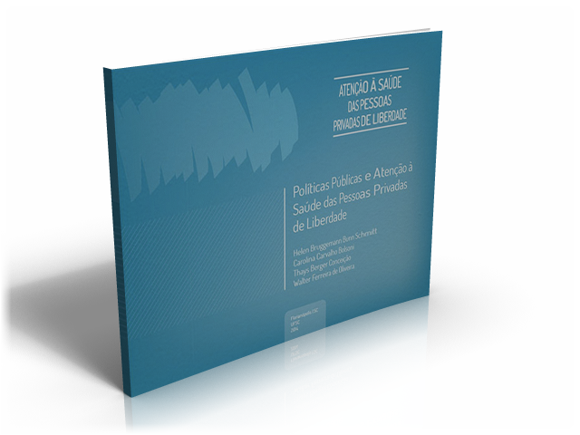
In-house training
Repurposed course content
into structured presentations
Five module course-book
All downloadable to the general public
Notes:
We also opted to repurpose the course content into structured presentations for in-house training. Along with the course-book, these presentations were offered to participants interested in extending this knowledge to their working teams. Later, we made both resources downloadable to the general public, so anyone interested in using them could do so.

Slide 16
Yes, it is possible
Notes:
We finished our project successfully proving that it is possible to train a diversified public scattered all over the country, working with a completely new and polemic subject, which is exactly what we did with the health professionals who work on health care for persons deprived of freedom in Brazil.

Slide 17
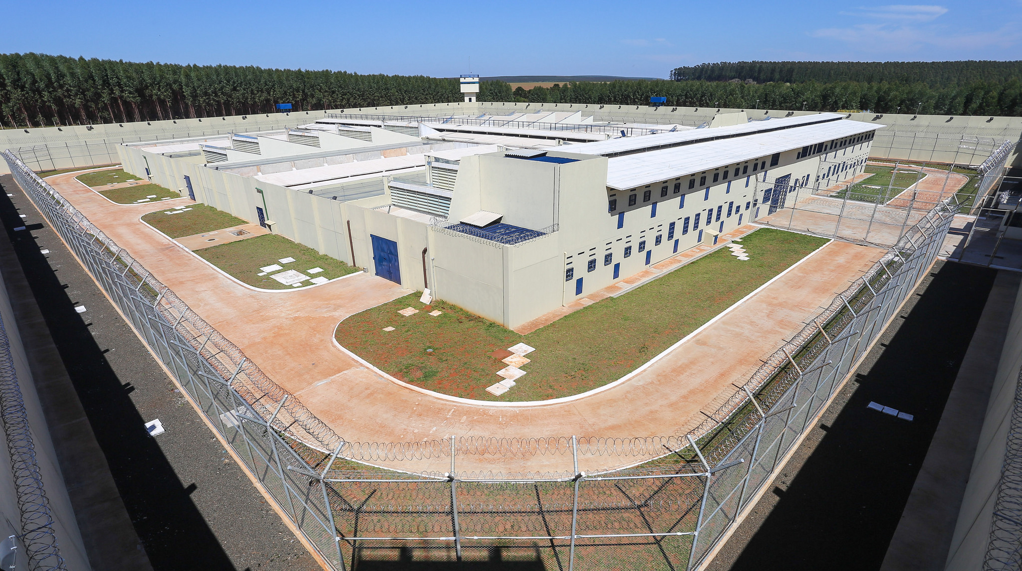
youtu.be/-BJCu9moQE4
Notes:
Detailed information about the results obtained are available in the video on the course's channel.

Slide 18
Thank you
Sheila Lindner, Ph.D.
sheila.lindner@gmail.com
Notes:
I would like to thank you all for the opportunity to share with you the results we have achieved with this project. I’ll be glad to help anyone who would like to know more about what we did, and please, feel free to contact me through the email sheila dot lindner at gmail dot com.
I hope you all have enjoyed.
Thank you.

