Slide 1
Transforming governance of healthcare in British Columbia's correctional facilities
Kate McLeod, MPH
PhD Student, University of British Columbia
Supervisors: Dr. Jane Buxton & Dr. Ruth Elwood Martin
Photo by Cathy Ferguson
Notes:
Good morning, my name is Kate McLeod and I’m a PhD student at the University of British Columbia. Today, I would like to talk about governance in the delivery of healthcare services in correctional facilities. In particular about the policy changes in British Columbia, Canada that are aimed at transforming the way we address health services for people who are incarcerated.

Slide 2
Governance
Policy and Strategic Plans
01
Generating Intelligence for decision-making
02
Coalition-building
03
Implementation & oversight
04
Accountability
05
Notes:
There are lots of ways that governance in health care services has been defined, and in many cases its by lists of fundamental principles and responsibilities of governance. Captured in many, to varying degrees of detail are these 5 actions.
Formulating policy and strategic plans
Generating intelligence: information and analysis for decision-making
Developing and maintaining coalitions and collaborative partnerships
Putting in place tools for implementing policy and oversight such as regulation; standard-setting; incentives;
Ensuring accountability which includes things like monitoring, transparency.

Slide 3
Prison Health Governance
Human Rights
Public Health
Economics
Notes:
As you are all well aware prison is a unique and important context for health and health care. Which makes thoughtful consideration of the governance models for healthcare services in prisons important from human rights, public health, and economic perspectives.
International standards such as The Mandela rules (7) and The Bangkok Rules (8) lay out the responsibility of the state to ensure that at a minimum, people who are incarcerated are provided, healthcare that is equivalent to the standard available in the community.
Governance models of prison health care also impact public health. People are constantly moving between prison and the community, this means that the consequences of short comings of strategic vison and policies for primary or preventive care in prisons, are borne by communities. Community healthcare services must respond to more acute, more complex cases requiring more care resources and hospitalizations. This has serious economic implications for our healthcare systems

Slide 4
“Health ministries should provide and be accountable for health care services in prisons and advocate healthy prison conditions”
Notes:
In most jurisdictions worldwide, healthcare in correctional facilities is under the Ministry responsible for corrections. The World Health organization and United Nations office for Drugs and Crime recommend that healthcare services in correctional facilities should be the responsibility of the health ministry.
There are many compelling arguments put forward for this model of governance. Importantly this would help to ensure clinical independence of healthcare providers. When healthcare providers report within the command structure of correctional services, many may experience role conflict or duel loyalties to the interests of their patients and of their employers. It is also argued that integration with the general healthcare system may support timely information sharing, continuity of care between prisons and communities.
Counter arguments have also been put forward in support of maintaining prison healthcare services under the portfolio of corrections. It Is argued that separating healthcare staff could mean that the voice of health might be lessened in prison management and influence of healthcare staff over other services such as nutrition and exercise might be lessoned, additionally, health care priorities may be seen as separate to the priorities of corrections which could lead to de-prioritization and in some cases underfunding of health services.

Slide 5
Country | MOH or Public Health Authority | Shared MOH/MOJ or MOH in some jurisdictions
Albania |  | x
Argentina |  | x
Armenia |  | x
Australia |  | x
Canada |  | x
Cyprus | x
Czechia |  | x
Denmark |  | x
Estonia |  | x
Finland | x
France | x
Iceland |  | x
Italy | x
Kosovo | x
Lithuania |  | x
Malta |  | x
Montenegro |  | x
Norway | x
Slovakia |  | x
Slovenia | x
Spain |  | x
Switzerland |  | x
Turkey |  | x
United Kingdom | x
Notes:
We know very little about current models of governance for healthcare services in correctional facilities. We do know that several jurisdictions have transferred responsibility for healthcare services to their ministry of health in full or in part. In the WHO Europe’s 2016/2017 Health in Prison Survey, 7 European countries reported that the Ministry of Health or the public health authority were responsible for healthcare services in prisons. Another 10 reported that responsibility is shared between the ministry of health and another ministry (such as the ministry of justice). In some jurisdictions, this may indicate a shared responsibility, in others it may reflect a transfer in only some jurisdictions within a country (as is the case for Catalonia in Spain).
There are also a handful of jurisdictions outside of Europe which have transferred responsibility including parts of Australia and parts of Canada.
There is very little reporting available from jurisdictions that have transferred responsibility to the Ministry of Health - it is retrospective and largely anecdotal. There is an urgent need for increased research and data on prison healthcare governance.
As I mentioned, only in parts of Canada is the Ministry of Health responsible for prison healthcare.
Data from: HIPED + Pont et al. Prison Health Care Governance: Guaranteeing

Slide 6
Governance in the Canadian Context
Federal Facilities
Provincial/Territorial Facilities
15 000 people
Sentence 2 years or more
Correctional Services Canada (CSC) under the Minister of Public Safety and Emergency Preparedness
Sentence less than 2 years
25,500 adults; 60% population held in remand
P/T governments responsible for healthcare delivery
Notes:
This is because in Canada correctional facilites are separated into federal and provincial jurisdictions by the length of sentencing
People who are held in federal facilities have been sentenced to 2 years or more, on any given day this is about 15 000 people.
People in Federal Facilities are excluded from the Canada Health Act which is our federal legislation for publicly funded health insurance.
Instead, healthcare is the responsibility of Correctional Services Canada which is rmandated to provide essential care and reasonable access to non-essential metal health care. Of course challenged in this are questions like what defines essential from non-essential care? What is reasonable access?
In provincial and territorial facilities people have been sentenced to less than two years or are being held on remand. healthcare is the responsibility of the province or territory as it is for the rest of the community. In most provinces and territories healthcare in correctional facilties is under the provincial Ministry of Justice or Corrections. However, three provinces have transferred responsibility and accountability for prison healthcare services to the provincial Ministry responsible for health.

Slide 7
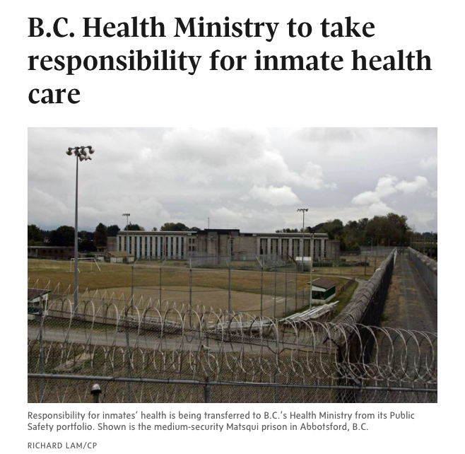
Study Aims
Understand the context, facilitators & barriers, expected outcomes as they are perceived by decision-makers in BC
Notes:
British Columbia is the third and most recent,they transferred responsibility for prison health care for the Ministry of Public Safety and Solicitor General to the Provincial Ministry of Health in October 2017.
The objective of my PhD project is to evaluate the impact of this transfer. In the current phase, I am conducting interviews with decision-makers and stakeholders in order to understand the context, facilitators and barriers and expected outcomes of the transfer process. This will help to provide a rich description of the experience in British Columbia and reveal lessons learned that will be valuable for other jurisdictions exploring integrative policies to address prison health.
These expert interviews will also inform the development of indicators for the second phase of my thesis project in which I aim to use cohort data to assess the impact of the transfer on transition of care between prison and community and on patterns of healthcare use following release.

Slide 8
Research Challenges
Authority & approval
“Consultation”
Whose story of the transfer is told?
Notes:
In this first phase of my project I have learned first-hand of some of the challenges that come with integrating two large, independent government bodies. Over the past 9 months I have been working to get approval to interview employees of the Provincial Health Services Authority, the body within the Ministry of Health who are tasked with overseeing healthcare in BC’s prisons. My project is the first research request to come following the transfer. The first challenge – was the need to establish who had the final authority to approve research about the prison healthcare in this new shared environment? My project had been approved by the PHSA’s internal research committee, but in the Memorandum of Understanding between the two ministries was an agreement that each would ‘consult’ with the other about any research projects taking place. This led to a second hurdle; which was understanding what was meant by ‘consult’? And how would we know if it had been accomplished? My research request went to the joint council of BC Corrections and the new PHSA Correctional Health Services. After this meeting I was asked to meet with BC Corrections research leadership. The concerns they raised led to the third challenge – whose story of the transfer was told? BC Corrections felt that the story my project captured would be one-sided. Only health – and one half of the story is a difficult way to describe a partnership. I have just begun the process anew and submitted an application to the BC corrections research board for permission to interview their employees. Though I am behind the time line I’d planned I am gaining insights I hadn’t imagined.

Slide 9
Context in BC
Improve continuity of care
Substance use and addictions
Address quality
International standards
Notes:
While working through these processes, I have had the opportunity to interview a small number of stakeholders outside of these two ministries. And to read limited reports and stories that have come out of the transfer, so I’d like to tell you a little about what I’ve learned so far about the context in BC and about the early signs of change.
First the context:
One of the priority aims of this policy change in BC is to improve the continuity of care between prison and the community. There is also a focus on mental health and supports for substance use and addiction. This is a particularly urgent issue in BC. In the spring of 2016 British Columbia declared a public health emergency in response to the rate of overdose and overdose deaths in the province.
The transfer was also a responses to recommendations to address issues of quality in healthcare in BC’s prisons. A coroner’s investigation in 2014 into the death of Edward Fast, and a report later that year by Parliamentary Secretary for Corrections both recommended exploration of a role for the Ministry of Health in serving people who are incarcerated.
In BC, as in other jurisdictions there was also motivation to align with international standards such as the WHO recommendation to integrate prison health with the broader healthcare system.
Though it is still early, there are already promising signs of change in the year since the transfer.
This included fewer health-related complaints reported to prisoner advocacy services
Elimination of wait times for opioid agonist therapy; new nursing staff hired to work with people transitioning with substance use and addictions. And an eye towards accreditation ni 2020

Slide 10
Thank you
Notes:
It is the hope that in understanding the transfer in BC we can inform policy frameworks and practices in BC, across Canada and around the world

