Slide 1
Policing Youth Engagement in High Risk Drug Use

Slide 2
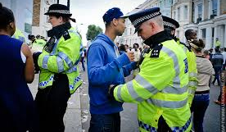
Policing Youth Engagement in High Risk Drug Use
Millions of youths use drugs
Many youths stop using drugs
All drug use can be risky
Use of ‘controlled’ drugs can be particularly risky

Slide 3
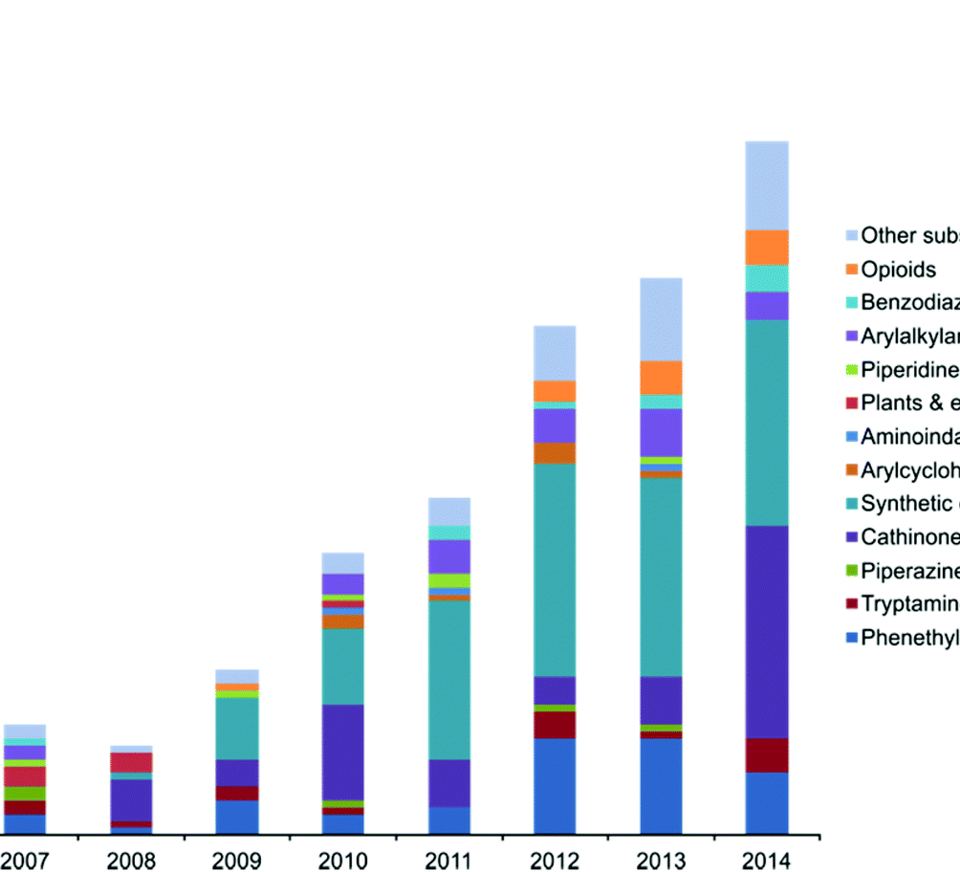
Quick summary of ‘controlled’ drug market:
High levels of adulteration (e.g. majority of cocaine contains levamisole)
High levels of contamination (e.g. pesticides, bacteria, fentanyls)
Highly potent substances (e.g. 400+mg MDMA ecstasy tablets, dabs)
Hundreds of additional NPS (e.g. cathinones, fentanyls)

Slide 4
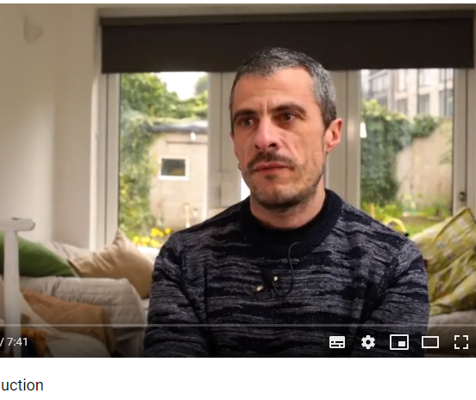
Supply-Side Harm Reduction?
Higher quality?
Feedback from peers
Reduction in street dealing/ recruitment into dealing?
Stop circulation of dangerous batches

Slide 6
Nutt, King and Philips (2010)

Slide 7
Rhodes (2002)

Slide 8
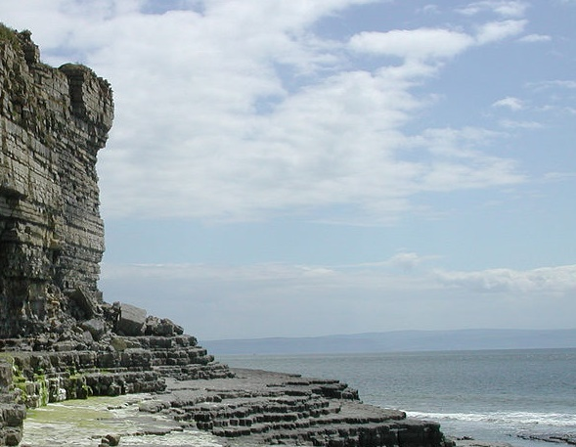
Cliff edge of Inequity (CEI)

Slide 9
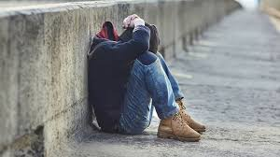

Slide 11
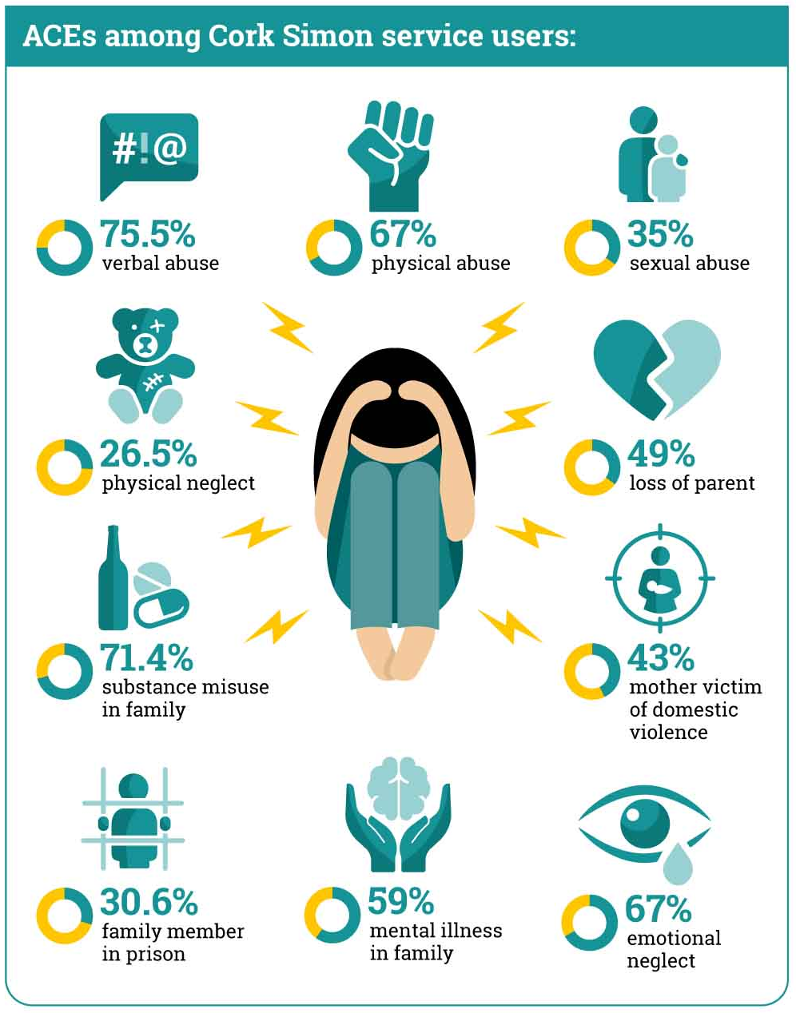

Slide 14
Motivational Interviewing
Restorative justice
Approx. 20,000 interventions with 10,000 U18s
Approx. 6% recidivism rate

Slide 15
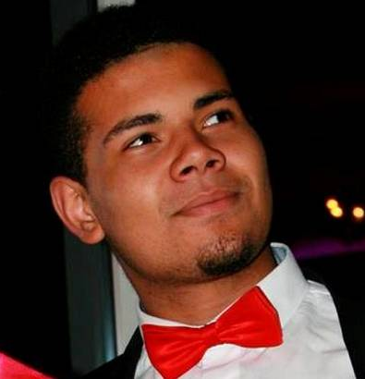
RIP
18
Student
Brother-of-friend/friend-of-friend/house-of-friend
Consumed 25 i-NBOMe sold as 2C-I in house party
Outlines need for drug checking services and clear Good Samaritan Policies

Slide 16
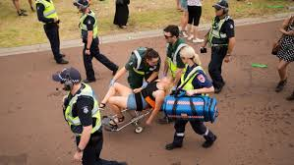
Festivals
NO SNIFFER DOGS!
High visibility policing can lead to people consuming all their drugs which can lead to crisis events
Policing of festival gates may decrease overall supply into the festival –is this desirable? (do we want youths to buy drugs in festival?)- and can lead to spikes in crisis events
High visibility policing may decrease the supply and consumption of drugs overall but may also decrease access to services
Some service providers suggest that high visibility policing/ private security should be reserved for near campsites to prevent assault and sexual abuse.
See: Ritter et al., 2017

Slide 17
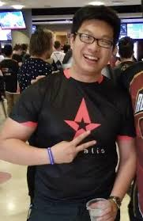
RIP

Slide 18
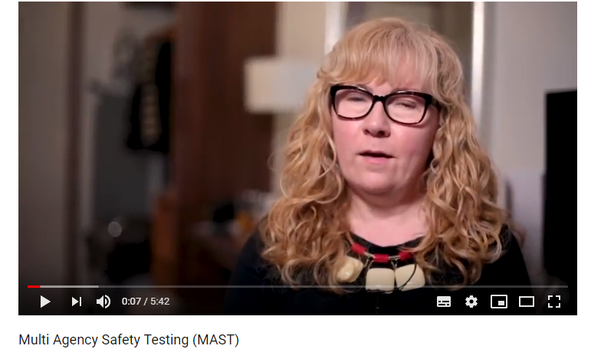
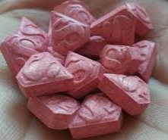
Drug Checking
Such services exist in Spain, Switzerland and the Netherlands for approx. 20 years
Pink superman pills detected and warning sent in Belgium and France but not in UK leading to 4 deaths
UK iteration
Supported by West Midlands and Durham police
Opportunities for brief intervention

Slide 19
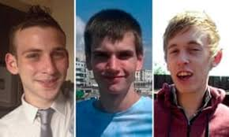
Chemsex
Bodies left in same graveyard
Lack of police competency on chemsex led to the delayed arrest of serial murderer Stephen
Stigma, discrimination and lack of cultural competence may lead to under reporting of chemsex-related crime (e.g. rape, assault, theft)
See: Stephen Morris
RIP

Slide 20
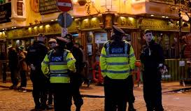
“Dirty Junkie”
John, 27
Mother went to Magdalene Laundries, brother was abused by the Brothers. In care institutions most of his life
Intravenous heroin use, benzodiazepine/z-hypnotic use
Stabilising, tells me that I am first person to treat him like a “human for a long while”
Police call him “dirty junkie” in front of his girlfriend and children
Subsequent reaction lands him into the prison
Immediately prior to prison becomes suicidal and is suspected of attempting to kill himself by overdose

Slide 21
Age restriction is an issue!
Majority of drug consumption sites have age restrictions, youth are turned away from these services (Schäffer et al., 2014)
Some sexual health services have restrictions regarding consent (e.g. condoms)
Some mental health services have restrictions

Slide 22
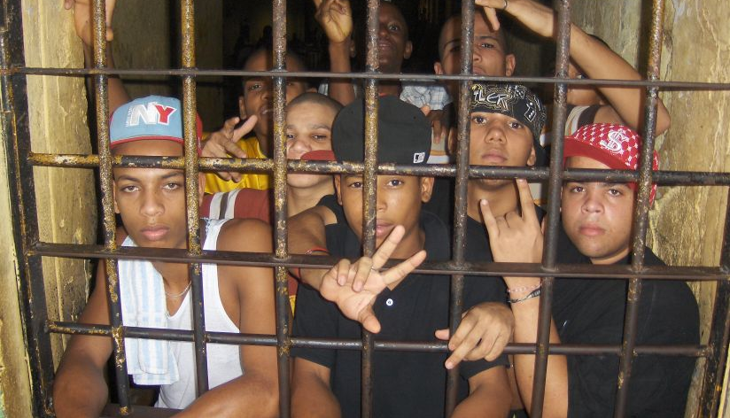
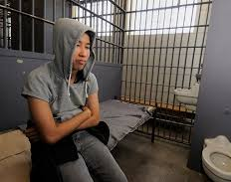
‘The Academy’
“I won’t mind going to prison. I will have time and space to do beat boxing. I’ll be there at most a couple of months and I’ll meet new people”
“it’s like an academy” (Gerry ‘The Monk’ Hutch; one of Ireland’s most famous criminals)
“the low availability of heroin which encouraged a shift from smoking to injecting; the scarcity of injecting equipment which fostered sharing networks far wider than outside prison; inadequate injecting equipment cleaning practices; and the rent of needles and syringes in exchange for the drugs” (Long, 2004)
“they used to leave out buckets of bleach” (former member of National Advisory Committee on Drug)

Slide 23
Recommendations for police
Use humanising and respectful language
Engage in primary, secondary and tertiary prevention e.g. focus on reducing ACEs/reduce impact on accumulation of social capital, facilitating access to harm reduction and treatment services
Discretion and diversion programs should be used wherever possible

Slide 24
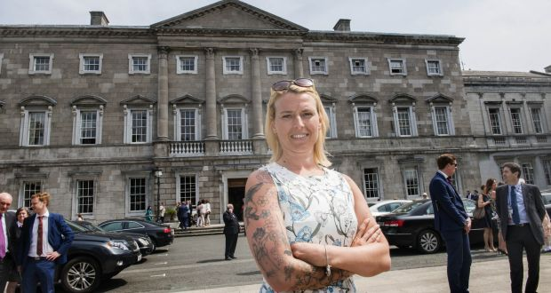
Senator Lynn Ruane
Grew up in socioeconomically disadvantaged area
Drug use history
Had a child at 15
Access Programme to Trinity College
Senator
Misuse of Drugs Amendment bill

