Slide 1
Opioid Overdose: Increasing 911 Calls Through Good Samaritan Law To Save Lives
Kim Lan St-Pierre
Family Medicine Resident
Université de Sherbrooke
Notes:
Today I will be discussing one of the strategies implemented to address the opioid overdose epidemic The title of my presentation is:______—
Today, I will be discussing one of the strategies. My presentation is titled: opioid overdose; increasing 911 calls through good samaritan law to save lives
In the context of the opioid crisis in Canada, numerous strategies have been proposed to respond to this epidemic. One of the strategies to address this issue is to increase access to treatment for people with opioid use disorder. Prevention of overdose, harm reduction strategies, and making naloxone readily accessible for overdose reversal by bystanders and EMS are just a few of them. The strategy that I will be adressing today increasing 911 calls after an overdose has occured.

Slide 2
Background
Opioid overdose is the leading cause of accidental death in North America
4000 deaths in Canada in 2017
94% accidental (unintentionnal)
911 calls (Emergency Medical Services) made in 30-65% of overdoses
Special Advisory Committee on the Epidemic of Opioid Overdoses. National report: Apparent opioid-related deaths in Canada (January 2016 to March 2018) Web-based Report. Ottawa: Public Health Agency of Canada; September 2018.
Canadian Community Epidemiology Network on Drug Use (CCENDU). Calling 911in Drug Poisoning Situations, March 2017.
Notes:
A little background: obviously most of you know that opioid overdoses have become the leading cause of accidental death in North America. In 2017 alone, almost 4000 deaths have been reported, of which 94% were unintentionnal.
unfortunately, Statistics show that people call emergency medical services only in 30-65% of cases. So we can say that in about half of opioid overdoses, people do not call9 11
contexte de l’étude : de 2013 à 2016, trousses de Naloxone et formation données à des membres du public, au retour des trousses usagées (donc après leur utilisation) on remettait un sondage pour savoir s’ils avaient appelé le 911 lors de la surdose et pour quelle raison

Slide 3
Good Samaritain Law to reduce barriers to 911 calls
Introduced May 2017
Protects bystanders and victims from:
Charges for possession of a controlled substance (i.e. drugs) under section 4(1) of the Controlled Drugs and Substances Act
Breach of conditions regarding simple possession of controlled substances in:
pre-trial release
probation orders
conditional sentences
Parole
The act does not provide legal protection against more serious offences, such as:
outstanding warrants
production and trafficking of controlled substances
all other crimes not outlined within the act
Canada.ca/opioids
Notes:
To address this issue, in continuity with harm reduction strategies, the Good samaritan drug overdose act was passed in May 2017 to reduce barriers to 911 calls in all provinces of canada.
Under federal law, it protects bystanders and victims from charges for possession of drugs and from breach of conditions for simple possession. so during a presumed opioid overdose, if someone calls 911, anyone present at the scene, including the victim, are immune from charges for possession and cannot be arrested, presuming that the person called is a good samaritan and called in good faith to save a life HOWEVER, AN IMPORTANT DETAIL to mention is that it does not provide legal protection for outstanding warrants, any other crimes, nor production and trafficking. This last one is really an issue because there is quite often production or selling of drugs at the scene of an overdose.
when a call to 911 is made, presuming that the people present at the scene are good samaritans, have good intentions and do want to save a life.
It protects anyone that called emergency medical services, whether they stay at the scene or not, and also protects anyone present at the scene as well as the victim. What does it protect from? It protects from simple charges of possession, but also breech of conditions for simple possession. However, an important thing to know is that it doesnt protect against everything. So it does NOT provide legal protection for more serious offences, such as outstanding warrants, charges for production or trafficking and any other crime.

Slide 4
Objectives
Explore facilitating factors and barriers to calling 911
Determine factors influencing arrest by police officers
Evaluate impact of the Good Samaritan Law (GSL) on intention to call 911 and subsequent arrest
Identify potential solutions
Notes:
The objectives of my study were to explore, on one side, the facilitating factors and barriers to 911 calls.
Établir les facteurs influençant les appels au 911 par les consommateurs
Déterminer les facteurs influençant l’arrestation par les policiers
Évaluer les enjeux de la LBS sur les appels au 911 et les arrestations
Identifier les pistes de solution pour augmenter les appels au 911

Slide 5
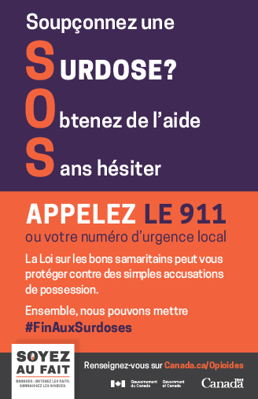
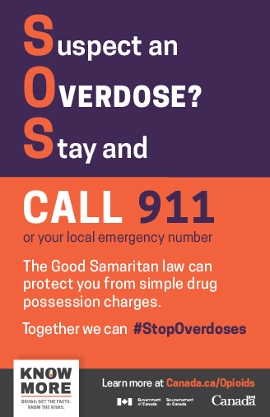
Good Samaritan Drug Overdose Act (GSL)
Notes:
These are 2 posters promoting GSL
Loi sur les bons samaritains secourant les victimes de surdose, LRO 2017, c 4, art 2.
"Arresting someone … doesn't cure addiction," he said. "If it were only that easy, we wouldn't have an addiction crisis right now."
A survey commissioned by the federal government last year found that most members of the general public they interviewed said they would be willing to call 911 in the event of an opioid overdose.
Emergency responders in Vancouver, Toronto and Ottawa say they haven't seen a noticeable increase in 911 calls for overdoses since the act was passed.

Slide 6
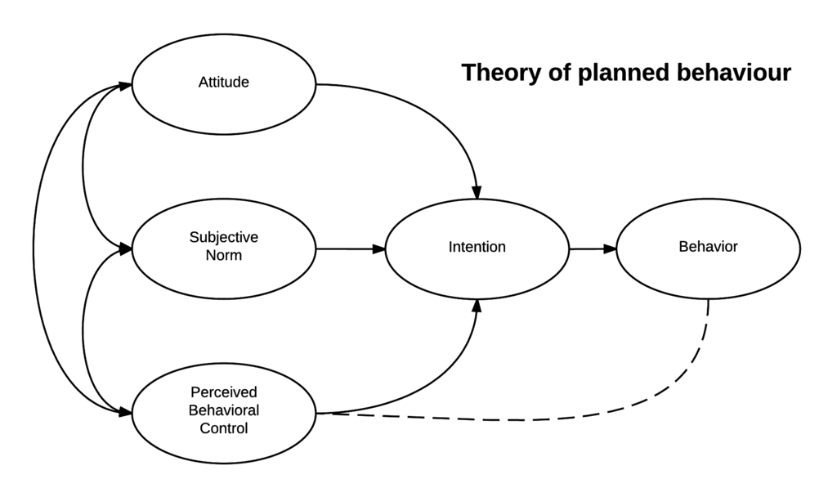
Methods I
Qualitative study
Semi-structured interviews
Interview guide based on the Theory of Planned Behaviour (TPB)
Theoretical model whose central hypothesis is intention predicts behaviour
Notes:
Theory of Planned Behaviour : Ajzen & Madden, 1986
Based on theory of reasonned behaviour with added concept perceived behaviour control based on the self-efficacy model by Bandura in social cognitive theory

Slide 7
Methods II
Phase 1: September 2017
Phase 2: August 2018
Interviews transcribed verbatim
Codified deductively based on the theory of planned behaviour (TPB)
Emergent themes analysed
Notes:
Rôles :
4 préventionnistes (Longueuil)
5 patrouilleurs (4 Valleyfield, 1 St-Hyacinthe)
Entrevues
Individuelles (n = 17) et en duo (n = 4)
Téléphoniques (n = 6) et en personne (n = 15)
5 intervieweurs différents :
1 résidente en médecine familiale (phase 1)
4 stagiaires en santé publique (phase 2)

Slide 8
Sample
Convenience sample
Peri-urban region of Montreal (Montérégie, Quebec)
Police officers n = 9
3 (Sept 2017)
6 (Aug 2018)
Opioid users n = 8
8 (Sept 2017)
Recruited from Community outreach and harm reduction centre
IV drug use

Slide 9
Results I: Opioid Users
Reluctance of opioid users to call 911 (barriers)
Fear of arrest
Fear of reprisals from peer users
Difficulty in recognizing overdose signs and symptoms
Facilitator: desire to save a life, wanting to do ‘’the right thing’’
Notes:
interesting part. We were really curious to know about the barriers and facilitators in making 911 calls during overdoses. The results we got are concordant with the current litterature. The main barrier
The results we got on the barriers to 911 calls were concordant with the current litterature.
The main barrier was fear of arrest. Opioid users reported a collective negative experience of police interactions and didn’t want anything to do with police officers. There was also a fear of reprisals from peer users, for exemple if they got someone else arrested. Another interesting point was the difficulty in recognizing overdose signs and symptoms. Users simply did not know how to recognize OD and when someone’s life was in danger. They’ll say, I thought the person was asleep and snorring, I thought they were passed out… until it was too late.

Slide 10
Results II: Police Officers
Discretionary power of arrest in overdose cases
Ambivalence between security and repression objectives vs health and harm reduction practices
Notes:
On the other side, we researched factors influencing police officers to arrest, or not, opioid users and people present at the scene of an overdose. The main difficulty PO reported was the lack of an official line of conduct. They had not received any training on how to manage overdoses and had a a lot of flexibility in how to manage the cases. This means that depending on the PO interviewed we had a lot of different responses, PERSONAL OPINIONS. Some prioritized security and repression, and arrested everyone, while others said it was mainly a health issue and treated it as such. PO obviously wanted to save lives, but they were also concerned about fighting crime and protecting the public, making neighbourhood safe

Slide 11
Results III: Good Samaritan Law
GSL remains misunderstood or unknown by both law enforcement officers and opioid users
Does not reduce fear of arrest in most opioid users
Users doubt police officers will protect their rights
Does not protect from production or trafficking
Police officers have not received training and question its applicability in practice
Notes:
Regarding GSL, we were very surprised to find out that
PO had not received any formal nor informal training on the law, hadn’t received any written or oral information on the law and didn’t feel they would be able to recognize situations in which it would apply. For example, some PO said they lacked the medical knowledge to identify an overdose compared to a severe intoxication, for instance, and thus wouldn’t have time to try to figure out if it applied or not and would just arrest the person and let te

Slide 12
CBC News, Aug 2018
https://www.cbc.ca/news/politics/good-samaritan-drug-overdose-fentanyl-politics-parliament-1.4786094
Notes:
https://www.cbc.ca/news/politics/good-samaritan-drug-overdose-fentanyl-politics-parliament-1.4786094

Slide 13
Verbatims- Opioid users
« Tu ne veux pas faire embarquer personne... parce qu’après ça, si quelqu’un est dans la marde parce que tu as appelé la police, je ne donne pas cher de ta peau. »
« Je ne savais pas que ca ressemblait à ca… je pensais qu’il dormait. Avoir su, j’aurais appelé. »
« S’il y a de la ‘’dope’’ sur la table, demain ou dans deux semaines, ils vont revenir. »
« Moi, si on doit sauver la vie d’une personne, je me câlisse du respect, de ce que les autres pensent. [...] Même s’il y a d’autre monde, je leur dirais : “Fais ce que tu as à faire; moi j’appelle l’ambulance’’. »
Notes:
« Ça se peut que la personne ne soit pas arrêtée sur le champ, mais là on sait qu’il y a quelque chose à cet endroit, donc à un moment donné il va y avoir une frappe et une perquisition. » - RP3

Slide 14
Verbatims – Police officers
« La personne qui vend, je vois ça comme de la criminalité vraiment. Parce que lui, il fait juste rendre tout le monde addict. »
« Mais en tant que policier, j’aime ça arrêter du monde, j’aime faire ma job. »
« On ne cherche pas pantoute, on fait de l’aveuglement volontaire. [...] Des fois, [les consommateurs] oublient [de la drogue], mais on regarde à gauche quand ça traîne à droite. »
Notes:
We also had different views and opinons from PO

Slide 15
Verbatims on Good Samaritan Law
« Je trouve que c’est bien, car ça ne les immunise pas de tout, mais ça protège leur sécurité pour les encourager à appeler les services d’urgence. [...] Même avant le projet de loi, on travaillait dans ce sens-là. »
« Je ne pense pas que les policiers vont fermer les yeux s’il y a de la drogue… Je suis sceptique. »

Slide 16
Discussion
Data triangulation
Theoreticl model (TBP) used to construct interview guides
Saturation reached for police officers
Recruitement difficulties during phase II: No opioid users interviewed one year after GSL implementation – impossible to assess impact on attitude and behaviour
All opioid users recruted from same community outreach center
Desirability bias
Notes:
As you can see, PO and opioid users reported the same experiences and being Able to get the opinion of these 2 groups and getting data triangulation is definitely a strength of this study. In addition, we used a theoretical model of behaviour to address different aspects of help-seeking behaviour in bystanders which allowed us to construct the interview guides we used with PO and opioid users.
We reached saturation with our 9 PO interviews
HOWEVER’ we faced Recruitement difficulties during phase II and thus No opioid users interviewed one year after GSL implementation. So it was impossible to assess the impact on attitude and behaviour of the GSL.
In addition, our sample was not as varied as we would have like, as opioid users recruted from same community outreach center. We were also concerned about a Desirability bias but in my opinion I think we were able to get pretty honest answers…

Slide 17
Recommendations to prevent fatal overdoses
Educate opioid users on how to recognize an overdose
Increase awareness of the Good Samaritan Law
Train police officers concerning appropriate application of GSL and interventions to modify attitude towards harm reduction practices
Medical presence (paramedics) exclusively in overdose calls?
Notes:
In light of the results we got, we realized, first, that opioid users did not know how to recognize an opioid OD and that is definitely a recommendation from our study.
second, we do need to increase awareness of the law with opioid users and PO
We need to train PO
However, with the results we got, we wondered if GSL would be enough to increase 911 calls… because even when users were informed of the law, they seemed to remain reluctant… another recommendation would be to have only paramedics respond to OD calls. I know some cities have applied this concept. We actually asked PO around Montreal what they thought of that.. they were skecptical, citing mainly security issues for paramedics. Another issue is that paramedics have to cover a much bigger territory and are not as much working. Having PO respond means they might get there 10-20 minutes before paramedics just because they’re are a larger force… and as they also carry naloxone they might be able to save a life as well….
In conclusion, I think we need to use the experience from PO and opioid users to implement some of these measures to prevent fatal overdoses.
Sensibilisation des consommateurs de drogues de rue à la LBS et aux signes de surdose avec l’aide des intervenants d’organismes communautaires
Formation des policiers, principalement des patrouilleurs, sur les deux types d’exemptions d’accusation stipulées par la LBS
Évaluation de la faisabilité d’envoyer les ambulanciers comme seuls répondants pour les cas de surdose présumée aux opioïdes

Slide 18
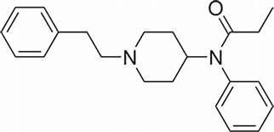
Questions?
Thanks to Dr Huy Hao Dao, Dr Lanthier-Veilleux, Dre Julie Loslier
Medical interns (Phase II): C. Azuelos, C. Bourbonnais, S. Brassard, A. Coderre
Police force: Longueuil, Ste-Hyacinthe, Valleyfield

Slide 19
Sources
Robichaud-Ekstrand, Sylvie et collègues. Les modes de comportements de santé, Recherche en soins infirmiers, No 64, mars 2001, p.59-77.
Loi sur les bons samaritains secourant les victimes de surdose, LRO 2017, c 4, art 2.
Special Advisory Committee on the Epidemic of Opioid Overdoses. National report: Apparent opioid-related deaths in Canada (January 2016 to March 2018) Web-based Report. Ottawa: Public Health Agency of Canada; September 2018.
Canadian Community Epidemiology Network on Drug Use (CCENDU). Calling 911in Drug Poisoning Situations, March 2017.

