Slide 1
Real-Time, Objective Measurements of Physiological Stress among Law Enforcement Officers in Dallas, Texas
Jennifer M. Gonzalez, PhD

Slide 2
Outline
Background & Significance
Aims
Methods and Data Collection
Findings
Summary

Slide 3
Background & Significance
Law enforcement officers experience premature mortality, disproportionate injury, cancer, cardiovascular disease, and suicide
Repeated exposure to stressful and traumatic stimuli is a possible mechanism
Acute and chronic stress may also drive high rates of divorce and family conflict, emotional dissonance and exhaustion; detachment, and cynicism
These adverse effects of stress have costly ramifications in terms of:
injury and workers compensation claims
compromised immune systems and increased illness and associated sick days
long- and short-term disability
early retirement and attrition
lost productivity and burnout

Slide 4
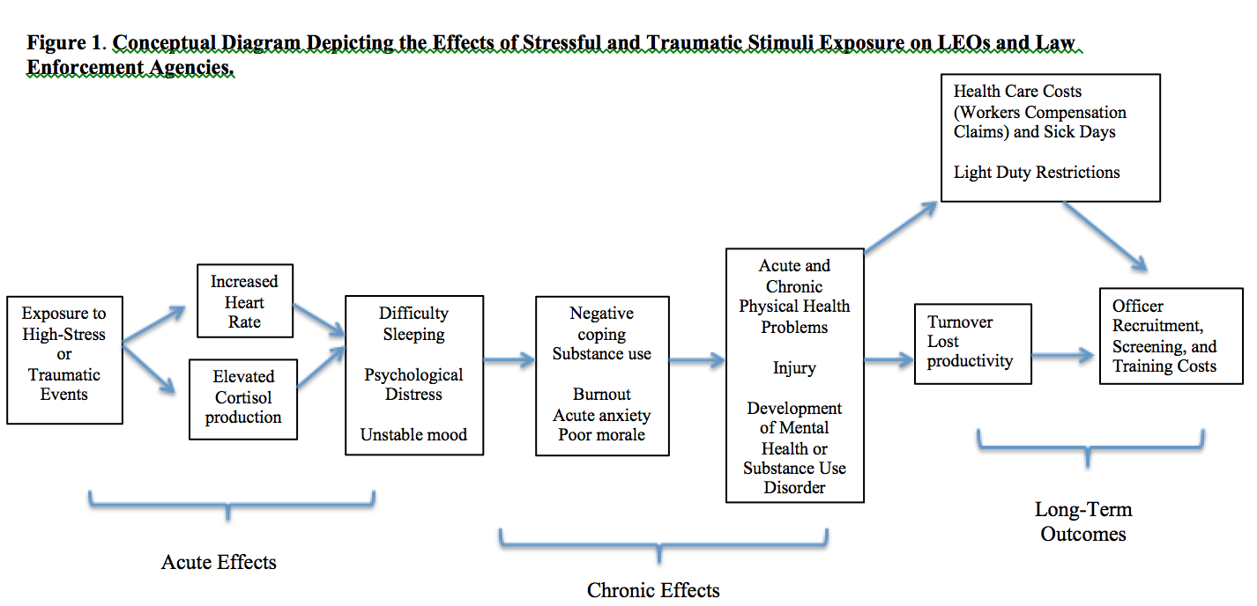
Method
Notes:
Law enforcement officers experience premature mortality, disproportionate injury, cancer, cardiovascular disease, and suicide

Slide 5
Aims
The Problem: We don’t know what about the officer day to day is stressful
Identify the factors that influence uptake of the FitBit data collection methodology, including LEO buy-in, attitudes and challenges associated with use
Goal: To identify the micro-stressors associated with the law enforcement occupation

Slide 6
Data Collection Methods
FitBit Charge 2
Self-Report
Focus Groups
Surveys
5 weekly surveys over a 1-month period
ClinCard Incentives
Logs
Activity Log
Stress Log
N=8 participated in a post-study focus group to discuss feasibility and stress
Occupational exposures: DPD activity data
Notes:
We recruited 10 dallas police officers while they were still in the police academy – stress was low.
FitBit calculated second by second HR, sleep, steps, exercise (METs)
-uploaded to the FitAbase system which we downloaded and matched with police activity data
Surveys measured non-occupational and occupational factors that cause non acute stress, like family conflict, traumatic experiences in childhood, organizational strain.

Slide 7
Feasibility

Slide 8
FitBit data collection
 | % Missing
1 | 20.6%
2 | 15.5%
3 | 37.4%
4 | 17.2%
5 | 74.3%
6 | 15.1%
7 | 20.7%
8 | 15.3%
9 | 17.7%
10 | 17.7%
Total | 25.5%
FitBit uptake was acceptable, much variation between officers
Perceptions of FitBit method / feasibility
Sleep
Steps
Notice a high heart rate
Slightly uncomfortable at first
Had to remove it in water
Notes:
Missing data is at the minute level

Slide 9
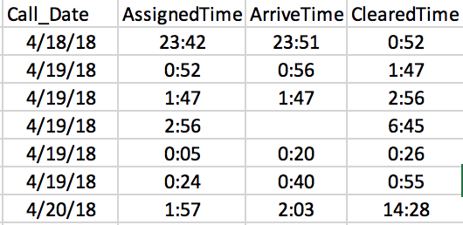
Tying of FitBit Data to Activity Records

Slide 10
Variation in Heart Rate

Slide 11
Micro-Stressors

Slide 12
Primary Stressors (Focus Groups)
Coping Mechanisms
CIT
meals
Physical Activity*
Family
Games
traffic stops
hypervigilance
manpower
shooting
Inadequate benefits
Low pay
Can’t turn off ‘cop mode’
Dept policy prevents them from “actually catching bad guys”
Notes:
Traffic stops: I think out of everybody, I think I've done the most traffic stops and every time that I do it and I still nervous once I turn my lights on. Once I've made contact with them I calm down.
Food: It’s really hard to eat healthy because you don’t know when you're going to eat. So if you're eating you don’t notice like it’s going be another seven hours before you get to eat or drink again. So you need to like it’s like, oh, whatever. I'm going do that now because I don’t know when my next chance to get to do any of that.
Everybody has got warrant and everybody has been to jail

Slide 13
Code 15 – Officer Assist
Code 46 -CIT
Notes:
The first is a graph of the heart rate for a single officer 2 hours before and after receiving an assignment of "Officer Assist." This should let you visualize the change for the audience. I'd note in particular how long the heart rate remained elevated (the red box). It also is a good illustration of just how messy this kind of intensive longitudinal data is to work with. Prior to receiving the call for the officer assist incident, this officer had a period where his heart rate was all over the place. I was able to track down in his activity log that he was dealing with another incident type at the time (code 46-CIT, best I can google Dallas PD uses that for possible mentally unstable individual that may be a danger to themselves or others). It really illustrates how important the level of detail y'all have collected in those activity and work reports is to sorting all of this out. Ultimately, we will need to code and prep probably every type of activity to make sense out of this....

Slide 14
Shooting of 2 DPD Officers
Notes:
Police shooting

Slide 15
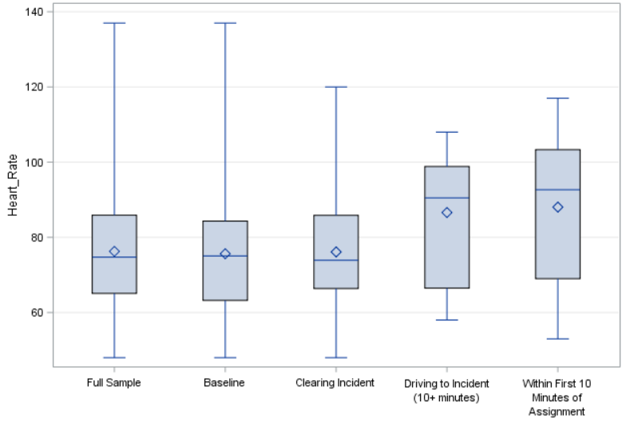
Officer Assist Call
Notes:
The second is the overall means for different categories related to whether an officer has received an officer assist call. The categories are mutually exclusive: 1. Baseline - the time before assignment and after the incident has been cleared 2. First ten minutes- the first ten minutes after getting the assignment 3. Driving to the incident - if there is any time after the first ten minutes before arrival 4. Clearing - Time from arrival to cleared The mean differences associated with that figure are as follows: Clearing vs baseline: 0.7 Driving vs baseline: 10.5 First 10 minutes vs baseline: 12.4

Slide 16
Summary and Conclusions
LEOs were highly receptive to FitBit methodology and eager to participate in a cohort study. LEO buy in was high
Heart Rate data were noisy and inconsistent
Tremendous between-officer variation in responses to occupational stimuli
Problems with activity records make it challenging to study responses to stress

Slide 17
Acknowledgements
Funding for this research was supported by Grant No. 5T42OH008421 09 from the National Institute for Occupational Safety and Health (NIOSH) / Centers for Disease Control and Prevention (CDC) to the Southwest Center for Occupational and Environmental Health (SWCOEH), a NIOSH Education and Research Center.

Slide 18
Thank you!
Jennifer M. Reingle Gonzalez, PhD
Associate Professor and Assistant regional dean
University of Texas School of Public Health
Dallas, Texas
Jennifer.m.reingle@uth.tmc.edu

