Slide 1
The cost of being a cop: police wellbeing and resilience
Commander Grant Edwards
Australian Federal Police
Twitter @strongCmdr

Slide 2
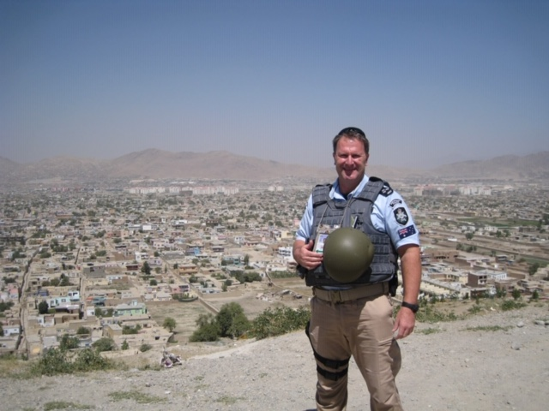
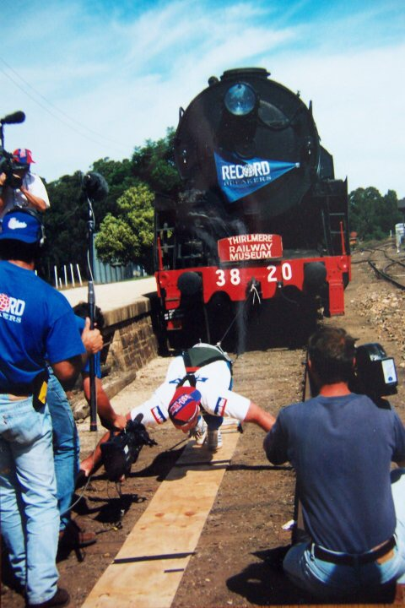
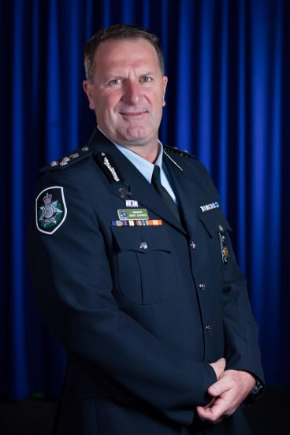
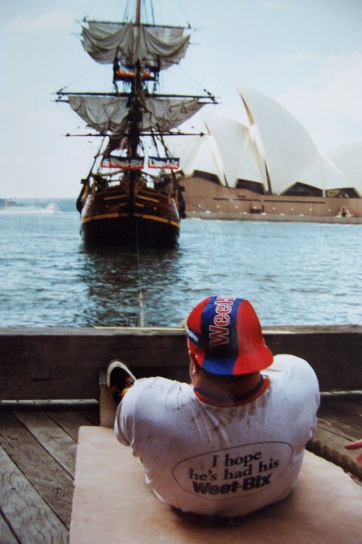
T
THE PARADOX

