Slide 1
Panelists:
Ava Bear
Herman Crain
Betty Watson
Facilitated by:
Dr. Chad Nilson

Slide 2
The Concept
An opportunity for human service providers to collaborate in a process of early risk detection, rapid intervention, and ongoing service coordination and support.

Slide 3
The Goal
To maximize the collective impact of multiple human service providers on community safety and well-being.
Notes:
The goal is to ultimately increase the impact of human service providers on CSWB by having them work together.
- CSWB is a holistic state that is more than just low crime, high graduation, good mental health…its about these multiple outcomes collectively impact quality of life

Slide 4
The Need
Police calls for service
Calls for ambulance
Addiction
Suicide risks
Vulnerable children
Elderly abuse
Violence against persons
Youth gang recruitment

Slide 5
The Desire
Return to an independent and holistic way of community life that embraces and supports all nation members for the purpose of a healthier and safer community.

Slide 6
The Importance of Collaboration
Legitimizes an issue.
Creates synergy and teamwork.
Closes service gaps.
Builds community capacity.
Broadens understanding of an issue.
Brings in new knowledge.
Improves service delivery and access.

Slide 7
The Reality
Notes:
- The reality is, that this model requires a complete paradigm shift.
This model represents a change in the way Muskoday First Nation meets the needs of its people.
It’s about reconstructing our relationship between the client and the service provider.
- This model is about making our services fit the needs of the people rather than expecting people to meet the needs of our services.
It’s about getting out in front of community and family issues before they become problems.
This model is also about finding ongoing, practical and pragmatic solutions to getting people the help and support they need.
And so, we’ve asked people to do things differently at Muskoday, to think differently, and to apply different solutions than they have in the past.
Most importantly, we’ve asked people to work collaboratively with that client….to step outside of their silos and approach service delivery in a holistic and community-wide fashion.
If a single client has multiple needs (addictions, housing, mental health), and they need help from the community with those needs, why on earth would we complicate things by making them have separate appointments with 5 different human service providers?? It’s about shifting our thinking to better serve the client and their families.

Slide 8
The Influence
Leading Practices
in multi-sector coordinated support
The Hub Model
of collaborative risk-driven intervention
Holistic Culture
of First Nation people
Notes:
The model I help First Nation communities develop has a number of influences….
We took the discipline of the Hub Model where consent is not appropriate.
We looked to the leading practices in case management, wraparound, clinical planning, service integration, healing circles.
We also were influenced by the holistic strength of community culture, and its tradition of helping one another.

Slide 9
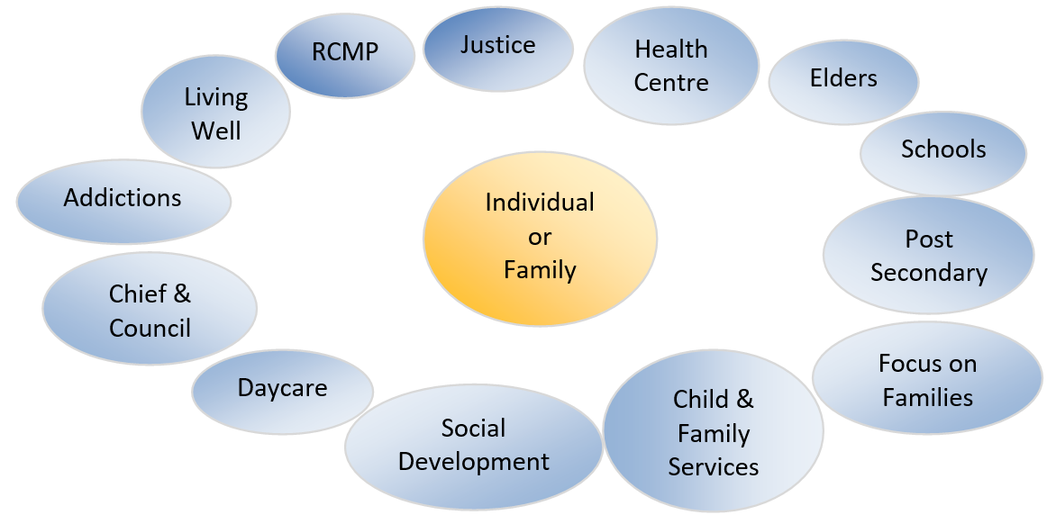
The Partners

Slide 10
Canada Wide Replication
90

Slide 11
The Supporting Evidence
increased service access
improved client-service provider relations
increased capacity of service providers
client stabilization
reduced elevations in risk
positive health and wellness outcomes
Notes:
- The guiding factor to our work, was the fact that there is a lot of supporting evidence.

Slide 12
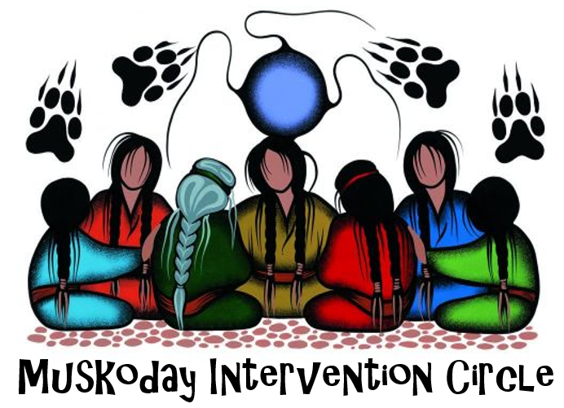
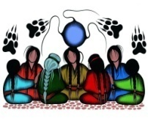
Model Design & Initial Launch
Notes:
The model I help First Nation communities develop has a number of influences….
We took the discipline of the Hub Model where consent is not appropriate.
We looked to the leading practices in case management, wraparound, clinical planning, service integration, healing circles.
We also were influenced by the holistic strength of community culture, and its tradition of helping one another.

Slide 13
First Replication
Notes:
The model I help First Nation communities develop has a number of influences….
We took the discipline of the Hub Model where consent is not appropriate.
We looked to the leading practices in case management, wraparound, clinical planning, service integration, healing circles.
We also were influenced by the holistic strength of community culture, and its tradition of helping one another.

Slide 14
The Design
TWO-PART MOBILIZATION PROCESS
NON-CONSENT
Collaborative Risk-Driven Intervention
CONSENT
Multi-sector Coordinated Support
Notes:
Getting to the design of MIC, there are essentially two components. Each are separate from one another, yet are interrelated for the purposes of supporting the client.
- Collaborative Risk-Driven Intervention focuses on immediate mitigation of risk factors through rapid service access.
- Multi-Sector Coordinated Support focuses on long-term development of protective factors through ongoing service coordination.

Slide 15
The Action
Rapid Intervention & Ongoing Support
Information Sharing
Risk Detection
Notes:
In essence, the actual action of the MIC team involves three main activities.
Detection of risk
Sharing of information
Rapid intervention and ongoing support

Slide 16
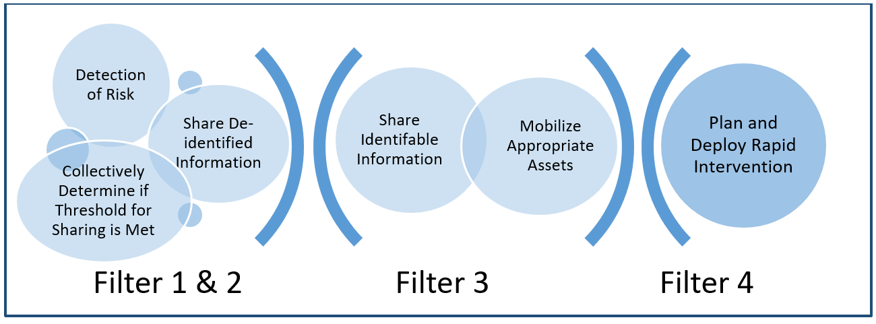
Four Filter Process
Notes:
Getting to the design of MIC, there are essentially two components. Each are separate from one another, yet are interrelated for the purposes of supporting the client.
- Collaborative Risk-Driven Intervention focuses on immediate mitigation of risk factors through rapid service access.
- Multi-Sector Coordinated Support focuses on long-term development of protective factors through ongoing service coordination.

Slide 17
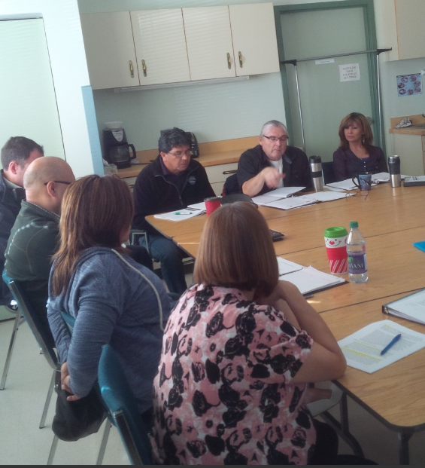
Collaborative Risk-Driven Intervention

Slide 18
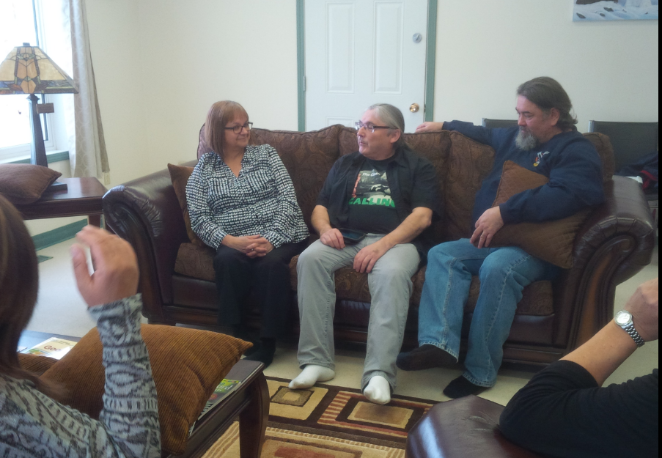
Multi-Sector Coordinated Support
Needs assessment
Collaborative planning
Ongoing monitoring
Continued support
Proper follow-up
Client-led closure
Notes:
- Somewhat different from the CRDI (or Hub process), is our process of MSCS.
- This is where a client does provide consent, and gets involved in actually planning their own longer-term service plan.
- Essentially, this process is based upon the notion that if a client is working with multiple human service providers anyway, why not work with them together.
- A lifetime of problems will not go away in one door-knock or intervention. So instead provide ongoing coordinated support to help that individual.

Slide 19
Data Collection
Systemic Issues
assets
needs
client goals
age
gender
progress
barriers
Risk Factors
Agency Involvement
Notes:
- De-identified data on risk factors, demographics, community assets and systemic issues are collected during the collaborative risk-driven intervention process.
- Individual client data is stored on needs, interests, barriers, goals, services, and progress within the multi-sector coordinated support process.

Slide 20
Efforts to Protect Privacy
Follow Four Filter Process of Hub model.
Have adopted a rigid information sharing protocol.
Client determines who has access to their information.
Notes:
Many of you are probably wondering how we can share all that client information without breaching privacy.
There is a strong disciplined filter process that we work within, when we do not have consent to share information.
Even once we receive consent to share information, we work under a fairly strict information sharing protocol.
Ultimately, we work hard to put a lot of power in the hands of clients concerning who has access to their information.

Slide 21
Key Ingredients
Multiple agency commitment
Shared ownership
Supportive Leadership
Collaboration as a priority
Change in perspective and approach
Notes:
Many of you are probably wondering how we can share all that client information without breaching privacy.
There is a strong disciplined filter process that we work within, when we do not have consent to share information.
Even once we receive consent to share information, we work under a fairly strict information sharing protocol.
Ultimately, we work hard to put a lot of power in the hands of clients concerning who has access to their information.

Slide 22
QUESTIONS
Dr. Chad Nilson
306-953-8384
LSCSI@hotmail.com

